Slide 1
Water Advocacy Program
Water Needs YOU!

Slide 2
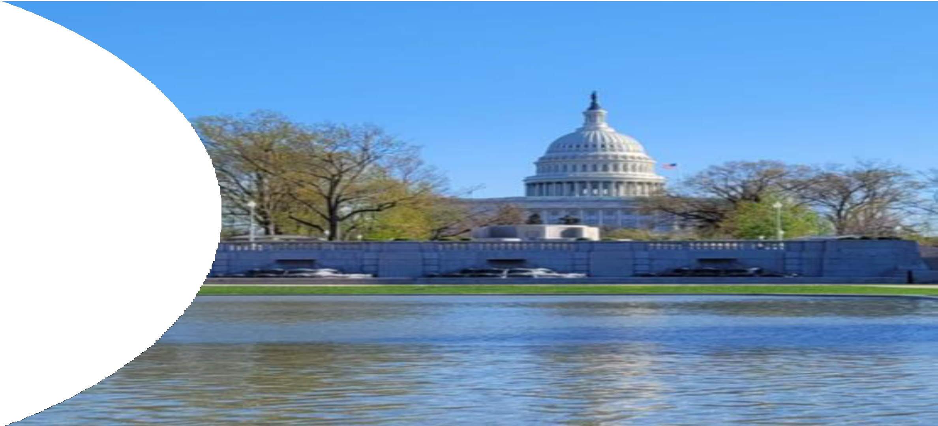

Capitol Hill
- where major water decisions are made

Slide 3
BUT FIRST….

Slide 4

The Water Advocates
Program helps you to reach
out to and connect with
elected officials on
important water quality
issues.
TAKE OUT YOUR
CELLPHONE

Slide 5

The Water Advocates Program helps you to reach out to and connect with elected officials on important clean water issues.
WEF Water Advocates Program

Slide 6



ater Environment
Federation"
-------------
the water quality people"
ater Environment Federation·
the water quality people•
Please urge Congress to reauthorize essential water infrastructure loan & grant programs at the highest funding levels!
Congress has begun the process of reauthorizing the water infrastructure grant and loan programs from the 2021 Infrastructure Investment & Jobs Act. All Members of Congress need to hear from their constituents about how critically important reauthorization and...
111
0
<

Slide 7


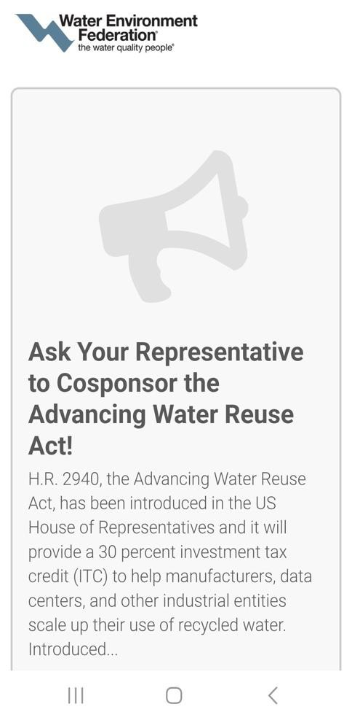
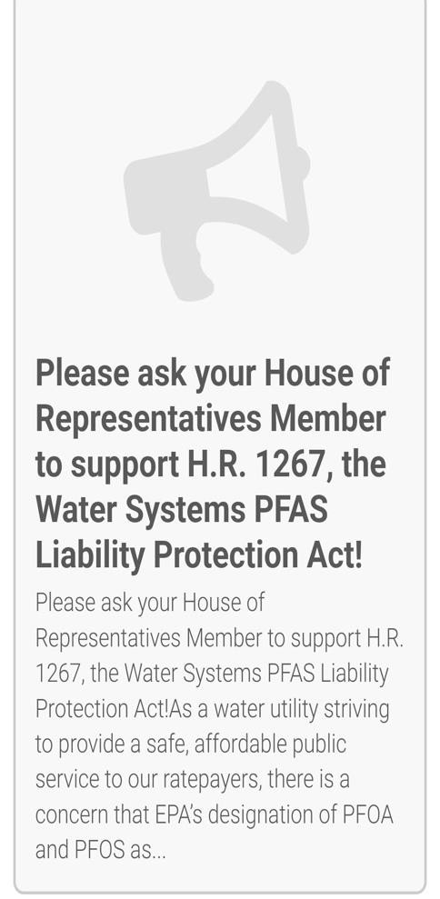
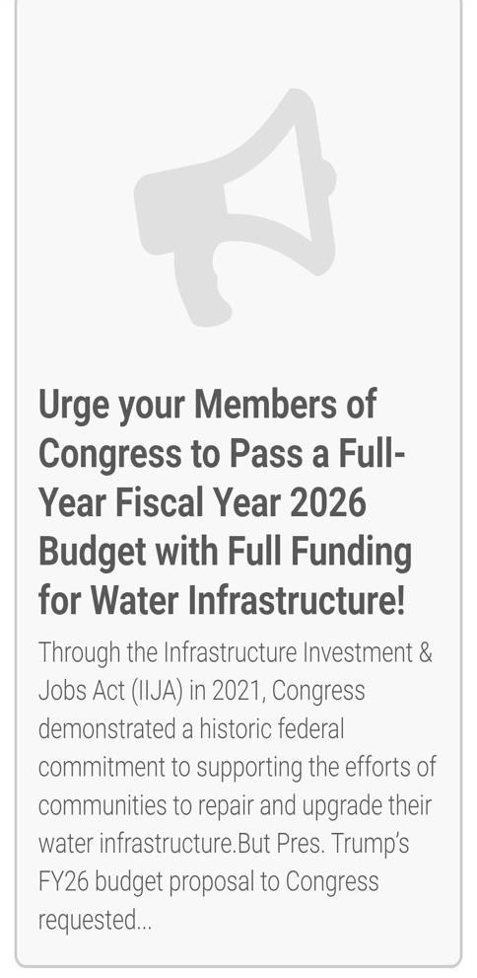
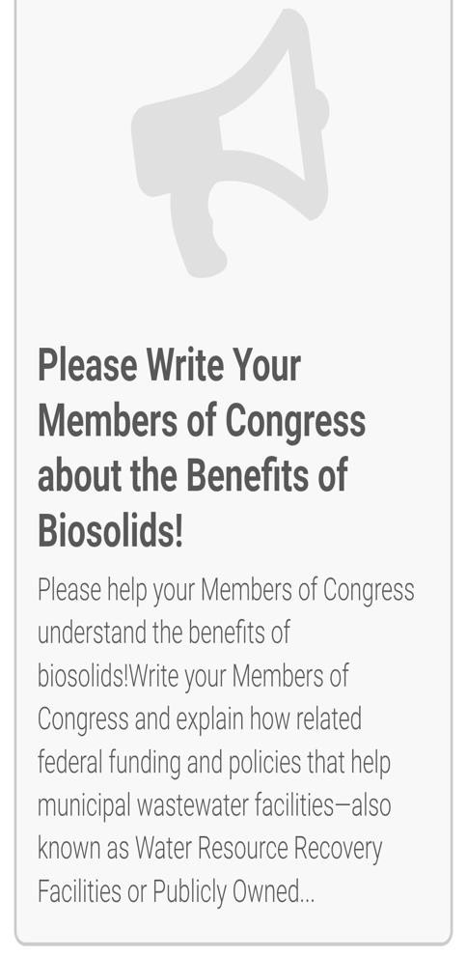
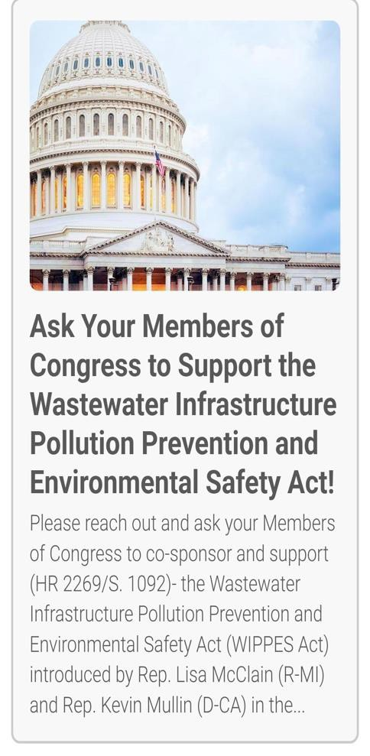
Water Reuse | PFAS | Funding | Biosolids | Wipes Labeling

Slide 8



Water Environment Federation"
the water quality people"
View Your Election Center
Enter your address to view voting resources
and your officials & candidates ZIP Code e
Sign Up for Alerts
Enter your information below to sign up. Enter Email
ZIP Code e
Find Legislation
View and search for legisla tion.
Enter Keywords
votervoice
Cookie Preferences Privac Y. PolicY.

Slide 9
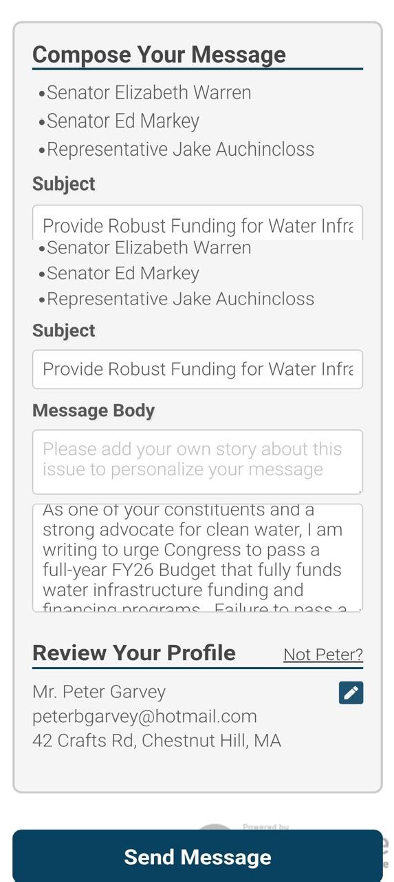
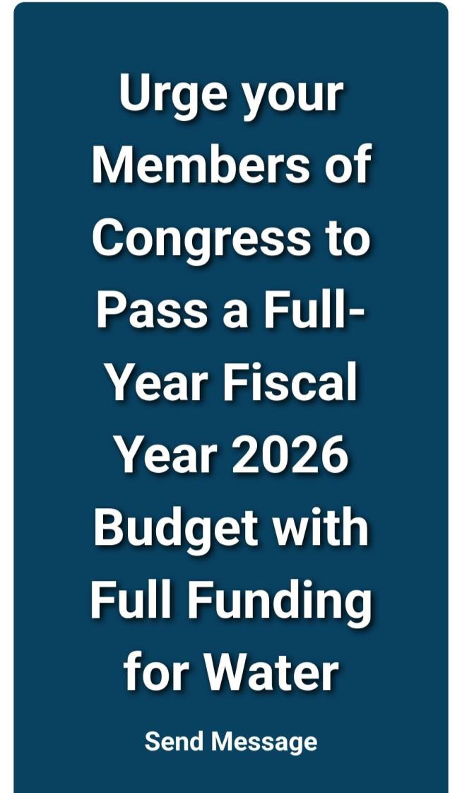
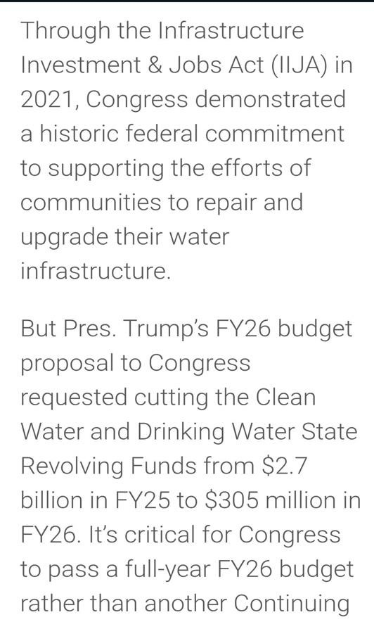
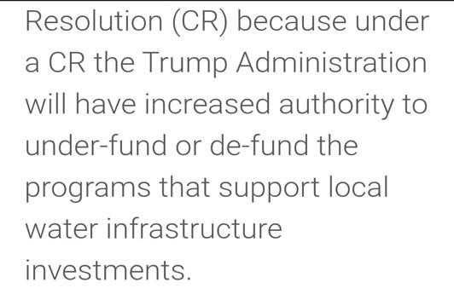
You can add introductory comments
You can edit the letter text

Slide 10
THANK YOU
IF WE DON’T SPEAK UP FOR CLEAN WATER – WHO WILL?
Peter Garvey (WEF Delegate at Large) – pgarvey@BETA-Inc.com
Vanessa McPherson (NEWEA Delegate) - Vanessa.McPherson@arcadis.com
WATER NEEDS YOU!

