Slide 1
Analytical methods for PFAS in environmental media
Christopher Impellitteri, PhD
US EPA Office of Research and Development
September 30, 2020

Slide 2
Outline
Types of analytical and standard methods
Drinking Water Sample Methods
  Method 537
  Method 533
Non-Drinking Water Sample Methods
  SW-846 Method 8327 – Direct Injection
  CWA/SW846 Method—Isotope Dilution
PFAS Analysis in Marine Waters
PFAS Analysis in Fish Tissue
Total Organofluorine Analysis using Combustion Ion Chromatography (TOF)
Total Organic Precursors (TOP)
Summary of EPA PFAS Methods as of July 2020

Slide 3
Methods ‒ Sampling
Guidance to avoid cross contamination in sampling
No teflon
Avoid contact with clothes, materials containing PFAS (e.g. some food wrappers)
See PFAS Analytical Methods Development and Sampling website
  Sampling guidance from states (e.g. MI)
  Interstate Technology and Regulatory Council Fact Sheet: Site Characterization Considerations, Sampling Precautions, and Laboratory Analytical Methods for PFAS
PFAS Quality Assurance Plan and Data Review technical brief

Slide 4
Non-Targeted Analysis
Targeted methods are methods which are applicable to a specific defined set of known analytes
  Analytical standards exist for quantitation
  Method only ‘sees’ analytes on the targeted list – will not measure others
  ‘One and done’ – once the analysis is complete, can’t look for other analytes
Non-targeted methods involve the use of High Resolution Mass Spectrometry (HRMS) capable of identifying all analytes in a sample, known and unknown
  Can quantitate those for which laboratory standards exist, otherwise may semi-quantitate based on known, structurally similar analytes
  Can screen for lists of known suspects, can discover new/unknown analytes
  Can store the HRMS data and go back later to look for analytes which were unidentified at the time of analysis, but which later become known

Slide 5
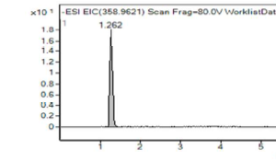
Targeted vs Non-Targeted
Explore unknown compounds using high resolution mass spectrometry. Identify a peak in a chromatogram and to ultimately predict the identity of this unknown.
Mass spectrometer assigns a high resolution mass for peaks observed in the chromatogram
Software calculates the exact number and type of atoms needed to achieve the measured mass
Fragmentation experiments allow determination of most likely structure:
Using mass, formula and structure, identity can be assigned by searching against databases of known compounds
Compare peak to commercial to confirm identification if possible

Slide 6
Types of Analytical Methods
Three broad classes of methods:
EPA Standard Methods
  Methods which have been through a multi-lab validation following a particular rulemaking or guidance effort and are available to support Agency regulatory or guidance activities
Research Methods
  Methods which have been developed by an EPA ORD laboratory for research purposes; QA’ed and peer reviewed via publication, but not multi-lab validated, not considered EPA Standard Methods
Developmental Methods
  Methods which are currently undergoing research, development and testing; might become Standard Methods or Research Methods

Slide 7
Types of Standard Methods
Three broad categories of EPA Standard Methods related to water:
Safe Drinking Water Act Methods
Clean Water Act Methods
SW846 Methods
These are generally targeted methods for solids and water.

Slide 8
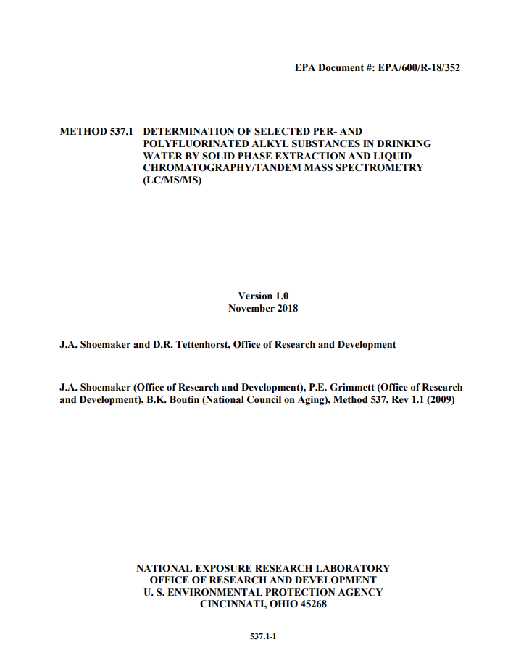
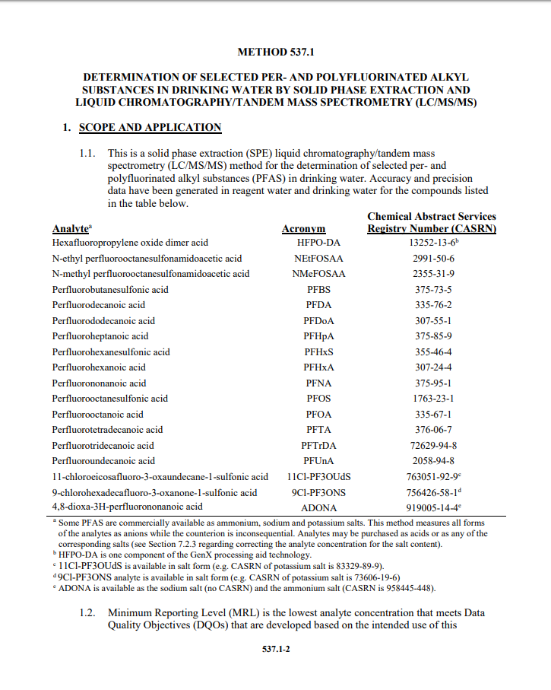
Drinking Water Method 537: Revision I
  Update: External lab validation for additional analytes by 537
    Perfluoro-2-propoxypropanoic acid (GenX chemical HFPO-DA, CAS 13252-13-6)
    Potassium 9-chlorohexadecafluoro-3-oxanone-1-sulfonate (9Cl-PF3ONS, CAS 73606-19-6)
    Potassium 11-chloroeicosafluoro-3-oxaundecane-1-sulfonate (11Cl-PF3OUdS, CAS 83329-89-9)
    Sodium dodecafluoro-3H-4,8-dioxanonate (ADONA, CAS 958445-44-8)
  Incorporated clarifications issued in EPA Technical Advisory- Laboratory Analysis of Drinking Water Samples for Perfluorooctanoic Acid (PFOA) Using EPA Method 537 Rev. 1.1
  Final published method (November 2018)
  LC/MS/MS with internal standards. Single lab lowest concentration minimum reporting levels (LCMRLs) range from 0.53-6.3 ng/L

Slide 9
Drinking Water Method 537: "Modified"
  Method 537 is often modified by analytical laboratories for use on non-drinking water samples
  If modifications are made that are not explicitly listed in 537 or 537 Revision 1, the method is not considered 537 by EPA
  The most common modification is inclusion of isotope dilution

Slide 10

Drinking Water Method 533
  Solid phase extraction/isotope dilution method targeting PFAS <C12
    Method 537 generally performs poorly for C4 compounds (e.g. PFBA, PFBS)
    Solid phase extraction, LC/MS/MS, Isotope dilution
    Will allow EPA to consider additional PFAS for monitoring under the fifth Unregulated Contaminant Monitoring Rule
    Released December 2019
      Analytical Methods Developed by EPA for Analysis of Unregulated Contaminants
Notes:
Solid phase extraction (SPE) liquid chromatography/tandem mass spectrometry (LC/MS/MS) method
Addresses 18 PFAS anions, may be derived from multiple salts
Includes HFPO-DA (GenX chemicals) and ADONA
Single lab lowest concentration minimum reporting levels (LCMRLs) range from 0.53-6.3 ng/L

Slide 11
Drinking Water Method 533
Method 533 | Both Methods | Method 537.1
1H, 1H, 2H, 2H-perfluorodecane sulfonic acid (8:2 FTS) | 11-chloroeicosafluoro-3-oxaundecane-1-sulfonic acid (11Cl-PF3OUdS) | N‐ethyl perfluorooctanesulfonamidoacetic acid (NEtFOSAA)
1H, 1H, 2H, 2H- perfluorohexane sulfonic acid (4:2 FTS) | 9-chlorohexadecafluoro-3-oxanone-1-sulfonic acid (9Cl-PF3ONS) | N‐methyl perfluorooctanesulfonamidoacetic acid (NMeFOSAA)
1H, 1H, 2H, 2H-perfluorooctane sulfonic acid (6:2 FTS) | 4,8-dioxa-3H-perfluorononanoic acid (ADONA)³ | Perfluorotetradecanoic acid (PFTA)
Nonafluoro-3,6-dioxaheptanoic acid (NFDHA) | Hexafluoropropylene oxide dimer acid (HFPO-DA) | Perfluorotridecanoic acid (PFTrDA)
Perfluoro (2-ethoxyethane) sulfonic acid (PFEESA) | Perfluorodecanoic acid (PFDA)
Perfluoro-3-methoxypropanoic acid (PFMPA) | Perfluorododecanoic acid (PFDoA)
Perfluoro-4-methoxybutanoic acid (PFMBA) | Perfluorohexanoic acid (PFHxA)
Perfluorobutanoic acid (PFBA) | Perfluoroundecanoic acid (PFUnA)
Perfluoroheptanesulfonic acid (PFHpS) | Perfluorobutanesulfonic acid (PFBS)
Perfluoropentanesulfonic acid (PFPeS) | Perfluoroheptanoic acid (PFHpA)
Perfluoropentanoic acid (PFPeA) | Perfluorohexanesulfonic acid (PFHxS)
 | Perfluorononanoic acid (PFNA)
 | Perfluorooctanoic acid (PFOA)
 | Perfluorooctanesulfonic acid (PFOS)
Bold indicates analytes listed on UCMR 3

Slide 12

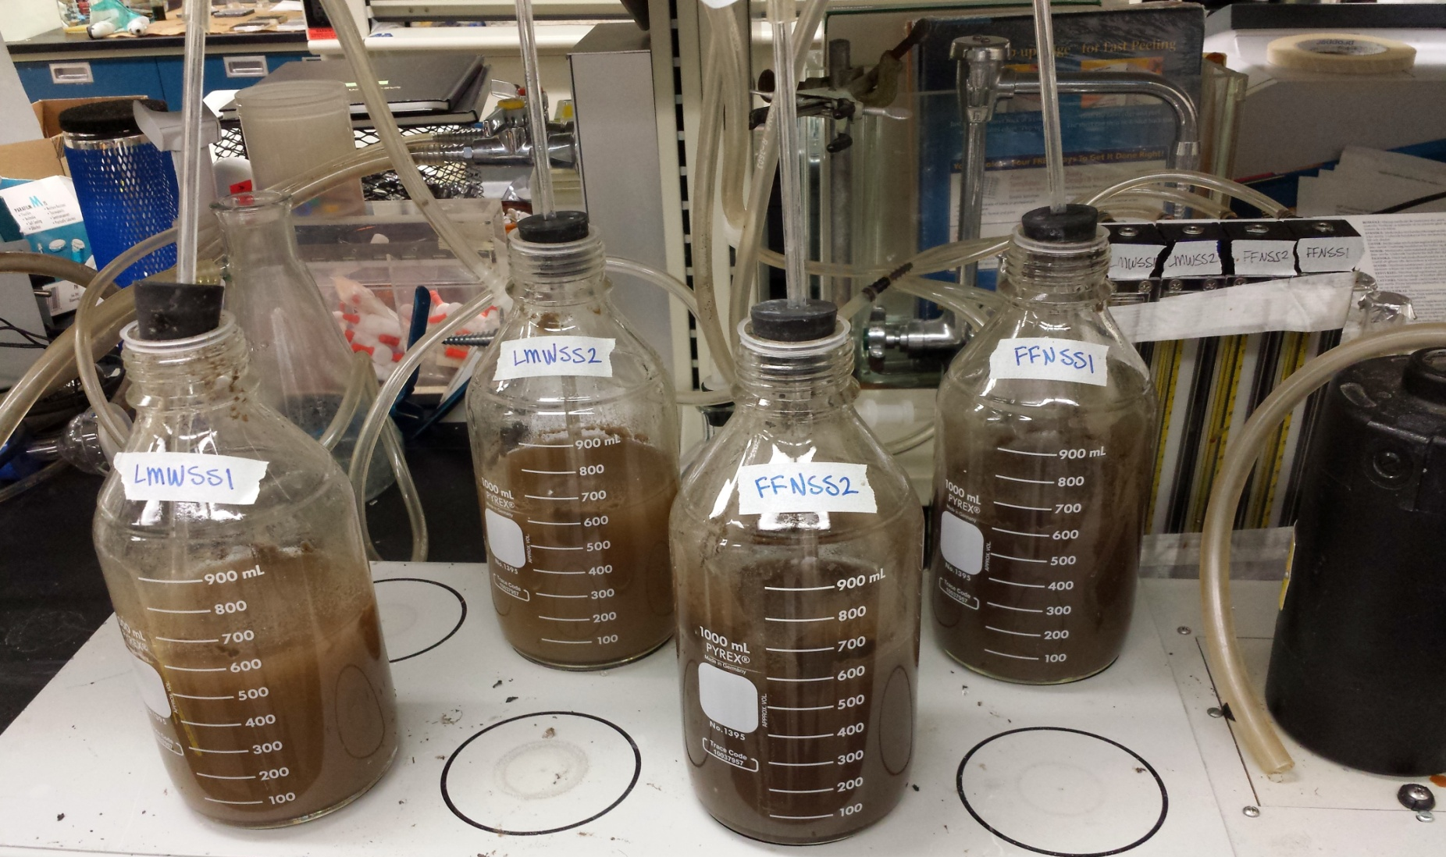
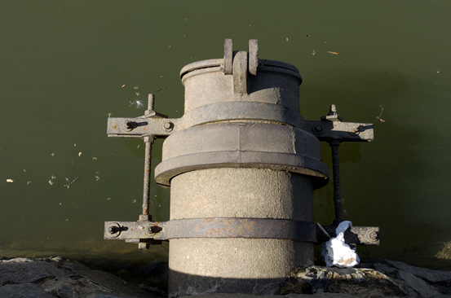
Non-Drinking Water Sample Methods:
SW-846 Method 8327—Direct Injection
  Non-drinking water aqueous matrices:
    Groundwater
    Surface water
    Wastewater
  Find a balance among sensitivity, ease of implementation, and monitoring requirements
      Simplicity
      Robustness
      Maximizing throughput for production lab use
      Minimizing sample transfers, extractions, filter steps, chemical additions (e.g., pH adjustments)
Validated Test Method 8327: PFAS Using External Standard Calibration and MRM LC-MS/MS
12

Slide 13
Non-Drinking Water Sample Methods:
SW-846 Method 8327—Direct Injection
  24 PFAS (including all target analytes in EPA Method 537)
  Commercially available standards (“native” and isotopically labeled)
  Direct injection-EPA Region 5/Chicago Regional Lab SOP
  Similar to draft American Society for Testing and Materials (ASTM) Method D7979
  Multi-laboratory validation study completed in 2018
  OLEM addressing public comments (closed August 26, 2019)
  Expected to be finalized in Fall 2020?
  Target Quantitation Limits: 10 nanogram/L
Associated preparation method 3512 for aqueous matrices
13
Notes:
Latest instrumentation (e.g. Waters Unispray) can lower Quant Limits to single ng/L

Slide 14
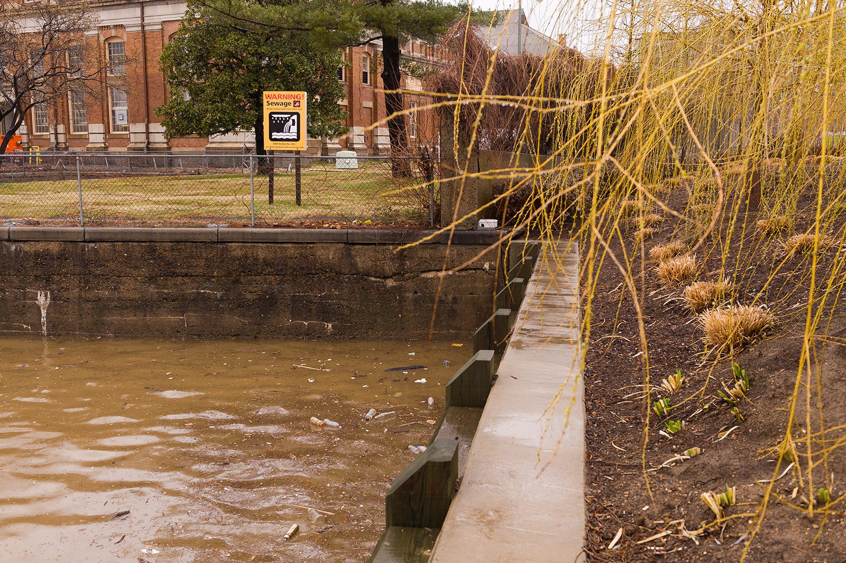
Non-Drinking Water Sample Methods:
CWA/SW846 Method—Isotope Dilution
  More complex method relative to direct injection; however will:
    likely be more robust for complex matrices (e.g., wastewater influents, biosolids). Account for matrix effects (e.g., sorption) through isotopically marked standard recoveries;
    afford options to meet DoD requirements; and
    allow users to perform a deeper dive based on screening (e.g. 8327) results.
  40 PFAS analytes-includes all analytes listed in 537.1, 533, and SW846 8327
  Non-drinking water samples
    Surface water, groundwater, wastewater
    Landfill leachates
    Solids (soils, sediments, biosolids, tissues)
14
Notes:
Minimizing sample transfers…”- Contamination issues
“Monitoring requirements”-vary for different states.

Slide 15
Non-Drinking Water Sample Methods:
CWA/SW846 Method—Isotope Dilution
  Build in flexibility
Columns
Elution schemes
  Single laboratory validation in progress
Collaborative effort among DoD, EPA Office of Water, EPA Office of Land and Emergency Management, and EPA ORD
Assuming single lab validation success (target Dec. 2020), multi-laboratory validation will follow over 2021
Method being developed in accordance with CWA and SWA-846 protocols for method development
  Target Quantitation Limits: 1-10 nanogram/L
Matrices include:
Wastewater (influent and effluent)
Groundwater
Surface water
Landfill leachate
Soil
Sediment
Biosolids
Fish tissue
15

Slide 16
PFAS Analysis in Marine Waters
  No EPA Approved method for PFAS in Marine Waters – ORD has a research method…
LC-MS/MS Isotope dilution method
  Method Details
  Covers 24 PFAS, Commercially available standards (“native” and isotopically labeled)
    Similar to those in EPA 537.1, 533, and SW 846 8327
    Target quantitation limits <1ng/L, with extracted samples
    SPE sample concentration – matrix elimination (up to 500 mL, Weak-Anion Exchange (WAX))
    Accounts for matrix effects (e.g., high ionic strength and DOM)
  Adapted to estuarine sediments and TOP assay
Contact: David Katz & Mark Cantwell EPA ORD/CEMM
(Katz.David@epa.gov; Cantwell.Mark@epa.gov)
16

Slide 17

PFAS Analysis in Fish Tissue
  No EPA Approved method for PFAS in fish tissue – EPA uses commercial laboratories’ proprietary methods
  LC-MS/MS with solid phase extraction and isotope dilution
  Similar to DW 533 and SWA 1600 but don’t dare call it a Modified Method…
  Method Details
  Covers 13 carboxylic and sulfonic acids from C4 to C12, plus PFOSA; now 33 analytes
  Quantitation limits ranged from 0.25 to 1.25 ng/g (ppb) for the 13 (0.38-4.09 ng/g for 33)
  Spike stable isotopically labeled PFAS analogs into 1-2 g fillet tissue sample
  Sample digested with caustic (KOH or NaOH) methanol solution to release PFAS from tissue
  Solids removed by centrifugation, aqueous solution processed by SPE extraction
  Injected into LC-MS/MS for analysis
  Longer chain PFAS C8+ most consistently present
  Contact: Sara Hisel-McCoy, EPA OW/OST (Hisel-Mccoy.Sara@epa.gov)
17

Slide 18
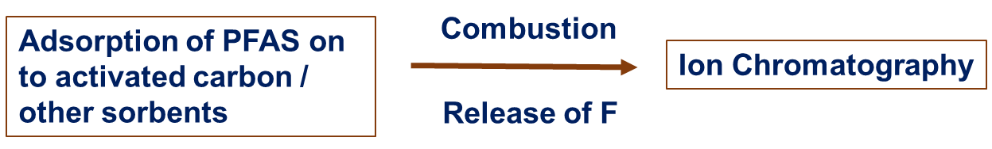
  Total Organofluorine Analysis using Combustion Ion Chromatography (TOF)
  No specialized or costly instrumentation required
  Applied for aqueous matrices and blood samples
  Removing the background inorganic F⁻ from the sample is important to make sure that the
  reported F⁻ is organic
  Can be developed on a wide commercial scale
  High priority for EPA. ORD working with OW-OST to develop a draft method in 2020
  Contact: Marc Mills, EPA ORD/CESER (Mills.Marc@epa.gov)
18

Slide 19
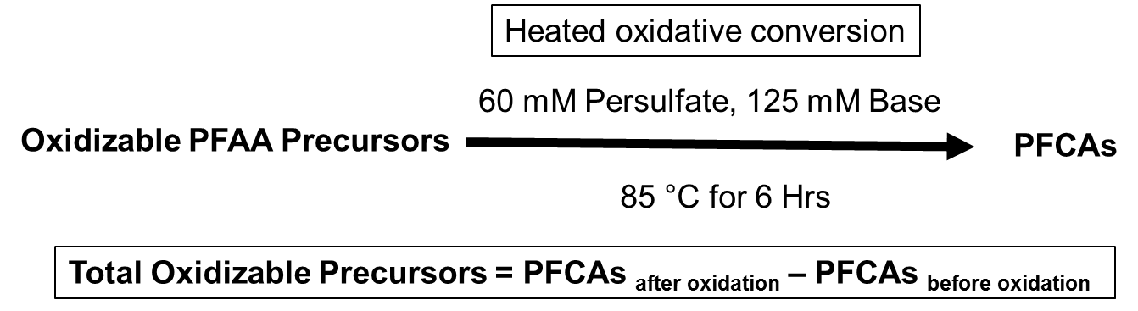
Total Organic Precursors (TOP)
  Developed by Houtz et al. No multi-laboratory validated standard methods
  Available from some contract laboratories
  Does not identify individual precursor compounds
  Applicable for aqueous and solid matrices
  Conservative estimate of the total concentration of PFAA precursors
  More expensive; sample needs to be analyzed twice for PFAS
  Contact: Marc Mills, EPA ORD/CESER (Mills.Marc@epa.gov)
19

Slide 20
Summary: EPA PFAS Methods, July 2020
  EPA has validated Standard Methods complete or in development for PFAS in water
  Final SDWA Methods 533 and 537.1 for available for drinking water (29 PFAS)
  Method SW846-8327 validated and undergoing final review for non-potable water (24 PFAS)
  Method CWA-1600 undergoing single and multi lab validation for non-potable water and solids (40 PFAS)
  EPA has or is developing additional methods for partner use
  Fish Tissue – Isotope dilution method for 13 PFAS has been used in national surveys
  Serum – Isotope dilution method (targeted and non-targeted) used in biomonitoring
  Ambient air and emissions – Sampling and analysis methods undergoing development and testing
  Total Organic Precursors (TOP) – Identify total PFAS load which may degrade to most persistent PFAS
  Total Organic Fluorine (TOF) – Potential rapid screening tool to identify total PFAS presence/absence
  High resolution mass spectrometry – Continued development and application of HRMS methods for discovery of novel PFAS, suspect screening, and non-targeted analysis
20

Slide 21
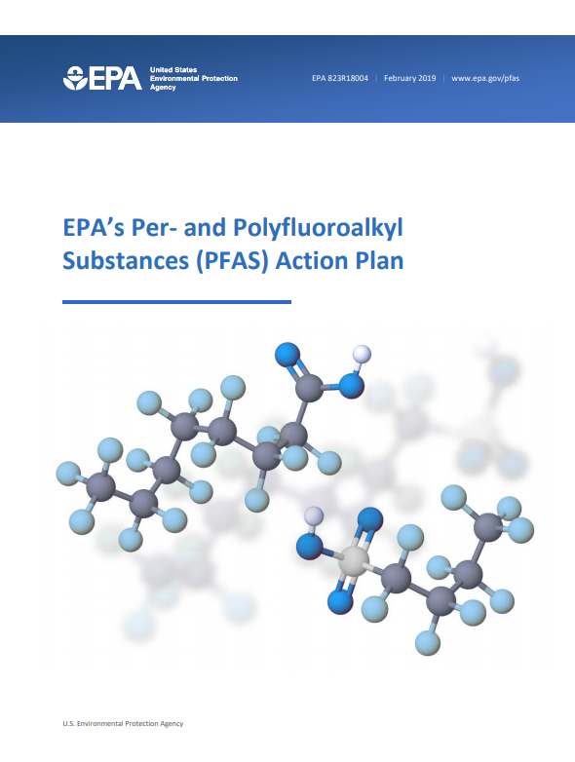
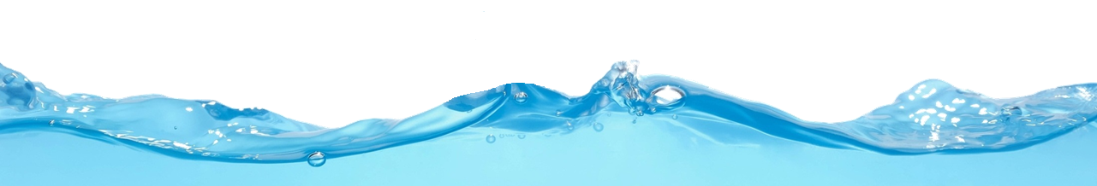
Contact
Chris Impellitteri, PhD
Lead, ORD PFAS Method Development
US EPA Office of Research and Development
Impellitteri.Christopher@epa.gov
513-487-2872
Acknowledgement:
Marc Mills and Andy Gillespie, US EPA ORD
The views expressed in this presentation are those of the individual author and do not necessarily reflect the views and policies of the US EPA.
21

